Slide 1

WAY TO ENTERPRISE
AWS
VTI ACADEMY
Author: duy.nguyenngoc1@vti.com.vn

Slide 2
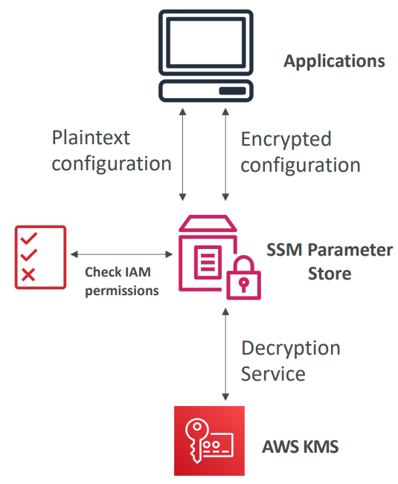
SSM Parameter Store Service
Provide Hierarchical storage to store environment variable and secret
a component in AWS Systems Manager (SSM)
Is a serverless, scalable, durable storage for configuration & secret
Usecases
  Save & manage environment variables
  Ex: username & password, database string, license code, ...
  Environment variables for serverless application
Tutorial: https://docs.aws.amazon.com/systems-manager/latest/userguide/systems-manager-parameter-store.html

Slide 3
SSM Parameter Store Service
Demo
  https://www.youtube.com/watch?v=zxi3M_rIE2k

Slide 4
Assignment
  Self-practice

Slide 5
SSM Parameter Store Service
Components
  Name
  Type-Value
  Tier
  Parameter policy

Slide 6
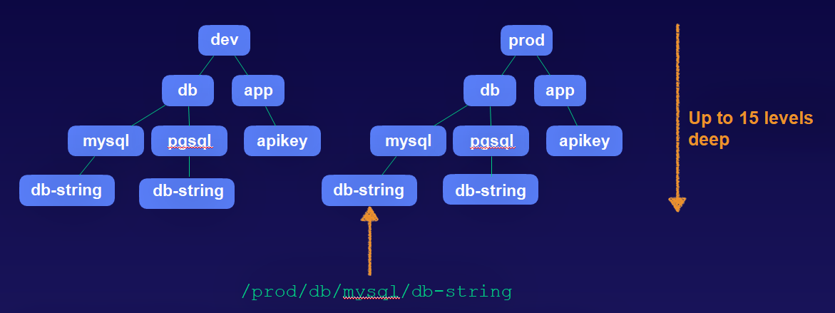
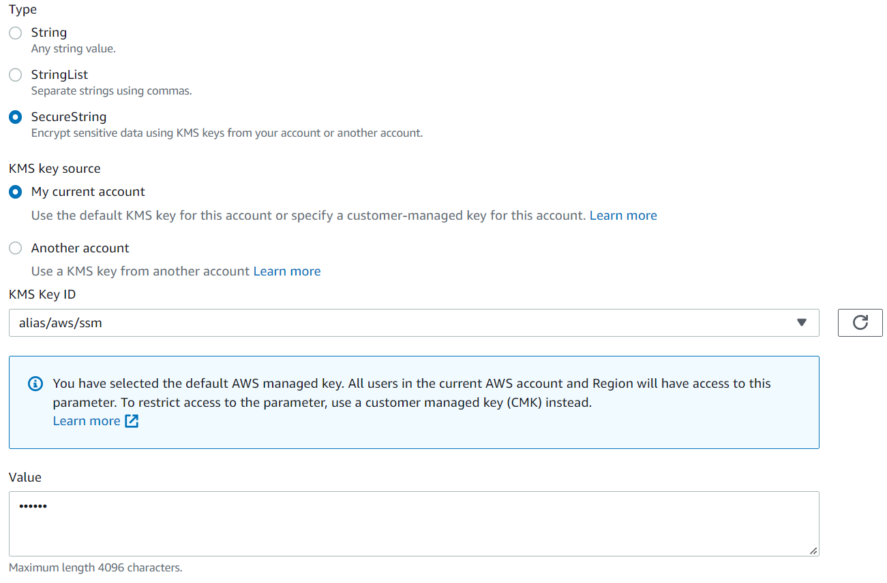
SSM Parameter Store Service
  Name
    Organized by in hierarchies
  Type-value
    Support 3 types: String, StringList, SecureString (String is encrypted with KMS)
    Value: text, encrypted text

Slide 7
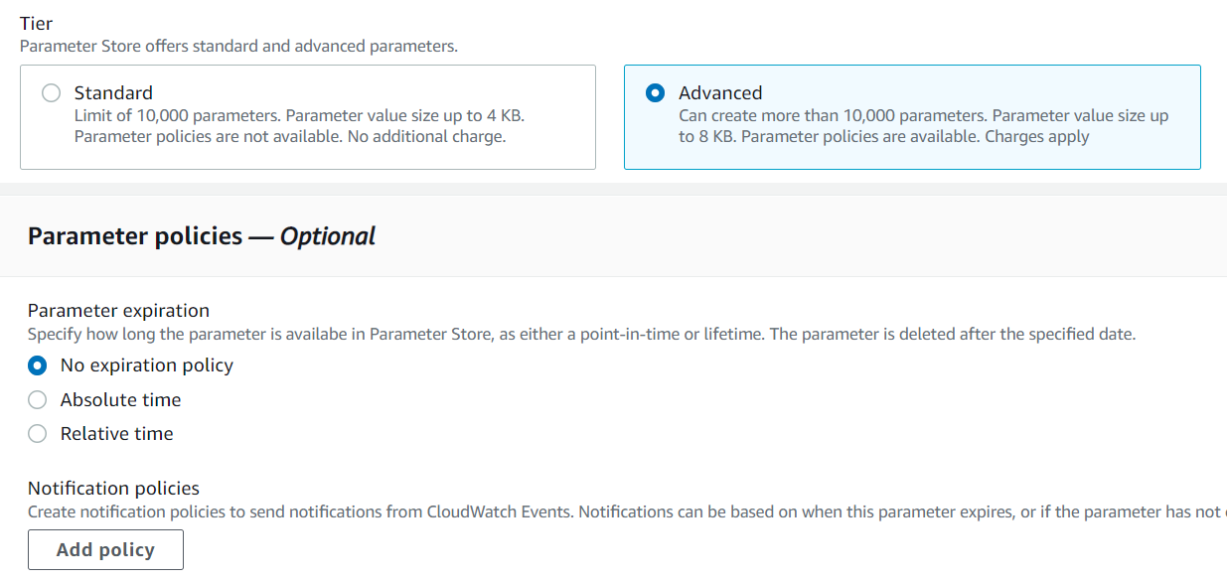
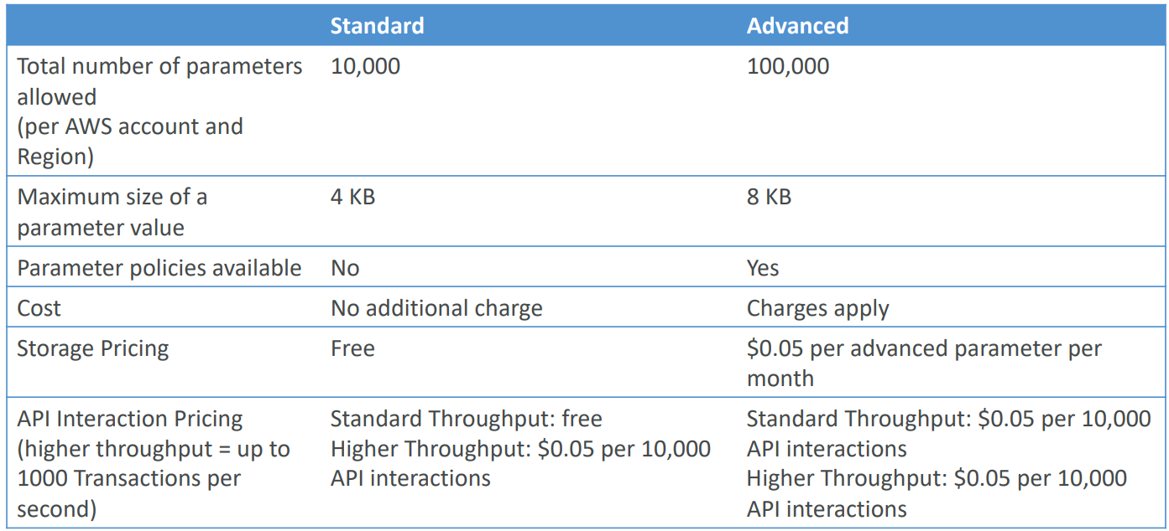
SSM Parameter Store Service
  Tier
    Standard (free)
    Advanced
    Intelligent-Tiering

Slide 8
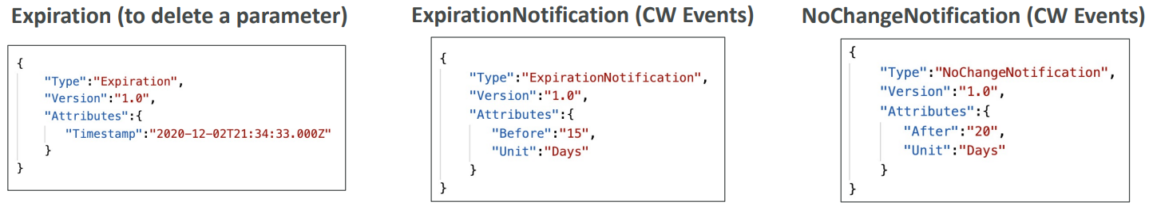
SSM Parameter Store Service
  Parameter policy
    Set TTL (Time to live) for parameters

Slide 9
SSM Parameter Store Service
Features
  Notification when parameters changing
  Organize and control access
  Support versioning
  History
  Multi A-Z
  Integration with AWS Services: EC2, ECS, Lambda, Secrets Manager

Slide 10
Q & A
Copyright © VTI Academy All Rights Reserved

